Slide 1


Detecting Natural Disasters with PyTorch
By Souhardya D. (19BCE1330)
Manav Jaiswal (19BCE1037)

Slide 2
Abstract
Cataclysmic events are wild peculiarities happening yearly which make broad harm lives, property and cause extremely durable harm to the climate. Anyway by, utilizing Deep Learning, ongoing acknowledgment of these fiascos can help the people in question and crisis reaction offices during the beginning of these ruinous occasions. As of now, there are still holes in the writing in regards to continuous cataclysmic event acknowledgment. In this paper, we present a model for the classification of disasters and labelling them. Along these lines, the demonstrated that precise acknowledgment of catastrophic events is conceivable utilizing a lightweight model and move learning. We trust that this report would prompt advancement of checking or observation frameworks that can perform exact, on-the-ground, and ongoing acknowledgment of cataclysmic events taking into consideration fast crisis reactions moderating the deficiency of lives and harms to properties.

Slide 3
Introduction
Disaster detection has been one of the most active research areas in remote sensing today because saving human lives is our priority once a disaster occurred.Because preserving human lives is our top concern after a disaster, disaster detection has become one of the most active research fields in remote sensing today. It is critical in the coordination of rapid response measures following a devastating disaster such as a landslide or flood. Previous research has mostly focused on detecting changes caused by disasters, relying solely on sensors and manually adjusting image processing techniques such as image algebra (band differencing and band rationing), post-classification comparison, and an object-based change detection method in. Machine learning is used to improve the efficiency of feature extraction in order to improve detection accuracy. A substantial quantity of literature has been written on machine learning-based detection. In the bags-of-visual-words setting, recommended hierarchical form attributes for detecting large-scale damage. The use of artificial neural networks to anticipate cyclone tracks is shown in. In the year 2010, assesses the efficacy of multilayer systems.

Slide 4
Introduction(Contd)
Prior catastrophe detection systems were primarily focused on sensors and were underdeveloped. As a result, they face a number of severe issues. For example, due to a lack of sensors, the range for inspecting the existence of a disaster is limited, and the accuracy of information transmission is low due to verbally conveyed information. Aside from that, the operators engaged are unable to process a large volume of satellite imagery and discover disasters in a timely manner. As a result, information may be misinterpreted or the onset of a tragedy may be overlooked. Based on prior studies, it is difficult to obtain instant performance improvement in disaster identification and management, as demonstrated by this case. As a result, the goal of this work is to develop an automatic catastrophe detection system by analyzing the existence of a disaster over a larger area using satellite photos and monitoring each individual disaster.
Key Words: disaster ,CNN, preserve human life,image processing algebra technique,multilayer

Slide 5
Problem Statement
Disaster Classification Model using CNN, for classification and labelling of different disaster categories with high accuracy is the sole purpose that we want to work on. Also, while learning and experiencing we tried to provide a novelty in the project with a multiclass(12) classification.

Slide 6


Dataset
Kaggle Natural Disaster Image Dataset

Slide 7
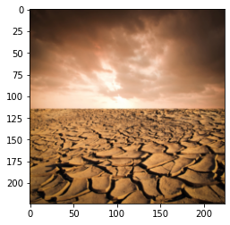
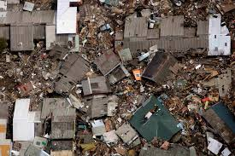
Dataset Examples

Slide 8
About Dataset
The dataset contains images of different disasters collected from different sources and stored category wise. A total of twelve classes disaster images are available and are as follows:
Damaged Infrastructure
Earthquake
Infrastructure
Fire Disaster
Urban Fire
Wild Fire
Human Damage
Land Disaster
Drought
Land Slide
Water Disaster
Non-Damage
Human
Non-Damage Buildings
Non-Damage Wildlife Forest
Sea

Slide 9
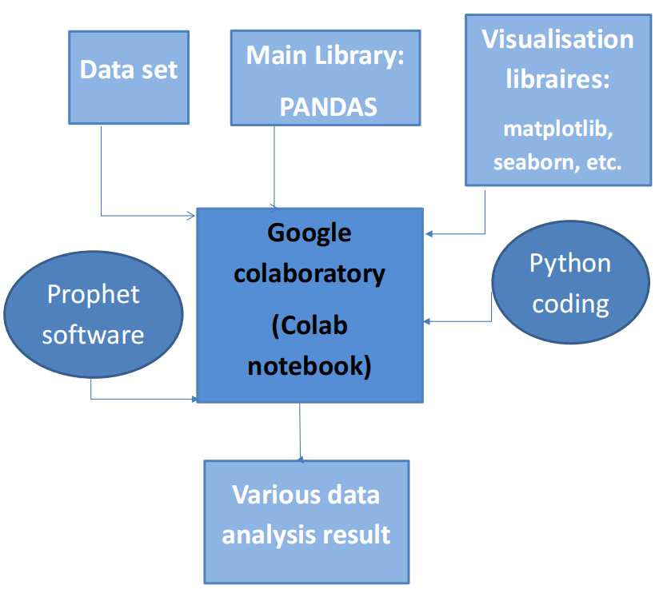
Block Diagram
High-level overview of major platform, software used, key process participants, and important working relationships

Slide 10
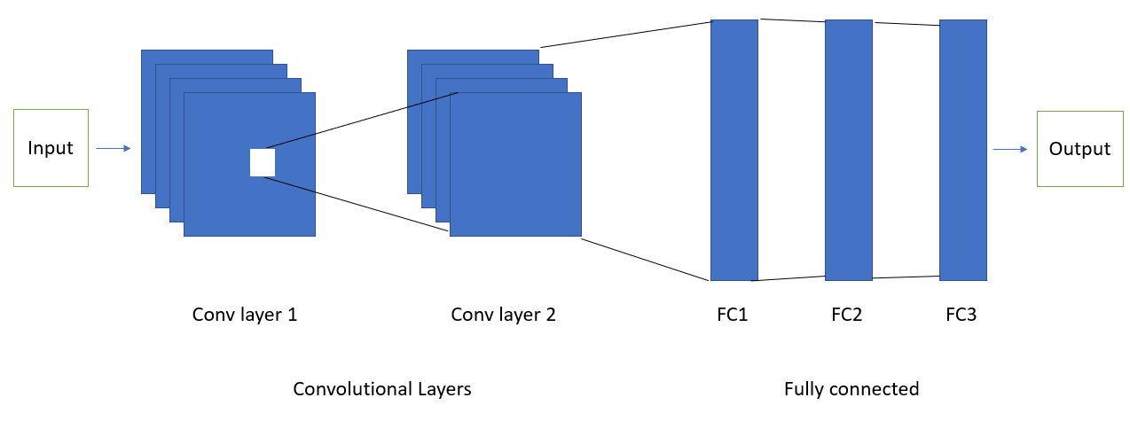
Architecture

Slide 11
Survey Of Existing System
Natural disasters cannot be prevented — but they can be detected.
All around the world we use sensors to monitor for natural disasters:
Seismic sensors (seismometers) and vibration sensors (seismoscopes) are used to monitor for earthquakes (and downstream tsunamis).
Radar maps are used to detect the signature “hook echo” of a tornado (i.e., a hook that extends from the radar echo).
Flood sensors are used to measure moisture levels while water level sensors monitor the height of water along a river, stream, etc.
Wildfire sensors are still in their infancy but hopefully will be able to detect trace amounts of smoke and fire.
Each of these sensors is highly specialized to the task at hand — detect a natural disaster early, alert people, and allow them to get to safety.

Slide 12
Literature Survey
Name | Algorithm | Disaster type
Experimentally defined convolutional neural network architecture variants for non-temporal real-time fire detection | AlexNet, InceptionV1, VGG13, InceptionV1-OnFire, FireCNN | Fire
Disaster image Detection model | Bag-of-Visual-Words (BoVW), SVM, VGG16, VGG15fine-tuned, VGG16fine-tuned | Earthquake, Hurricane, Flood
CNN and GAN Based Satellite and Social Media Data Fusion for Disaster Detection | AlexNet (4096), GoogleNet, VGGNet 19 (4096), ResNet (with 50, 101 and 152 layers) | Flood
. Enhancing Flood Impact Analysis using Interactive Retrieval of Social Media Images | SVM, Sequential CNN | Flood

Slide 13
Details Of Software & Hardware
Details of Hardware & Software Hardware Requirements: Laptop (32-bit or 64-bit architecture, 2+ GHz CPU, 8 GB RAM.) Software Requirements: ● Operating System: Windows 7/8/8.1/10, Linux ●Tools and Framework: Deep learning, PyTorch ● Language Requirement: Python ● Server: Locally hosted Technology Used: Image pre-processing, PyTorch, Google Collab, Deep Learning, Image Processing.

Slide 14
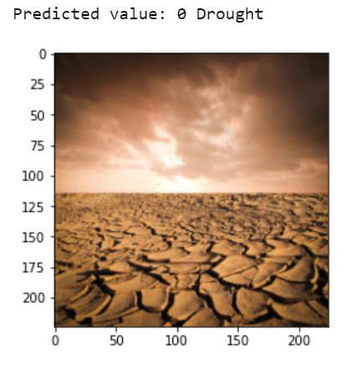
Results
Many academics have attempted to detect natural disasters using various deep learning algorithms. However, utilizing deep learning techniques to detect natural disasters still has a number of drawbacks, including noise and major class imbalance issues. We suggested a multilayered deep convolutional neural network for natural disaster identification and intensity classification to overcome these issues. We achieved an accuracy of 81.83%. Due to its multilayered structure, the suggested model earned the maximum accuracy when compared to other state-of-the-art approaches.

Slide 15
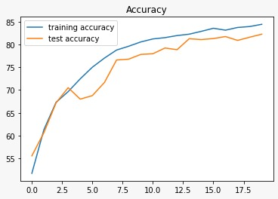
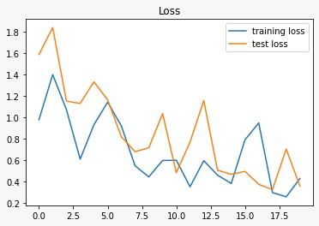
Accuracy and Loss graphs

Slide 16
THANK YOU

